Slide 1
UT Bathroom Services (UTBS)
David Chun, Zoe Ng, Joel Wang, Hans Xu

Slide 2
Project Overview
An Android app that allows users to locate bathroom and water facilities on campus
Locations are ranked by geographical proximity, cleanliness, user reviews, and other criteria
User based reviews form central database and are factored into recommendations

Slide 3
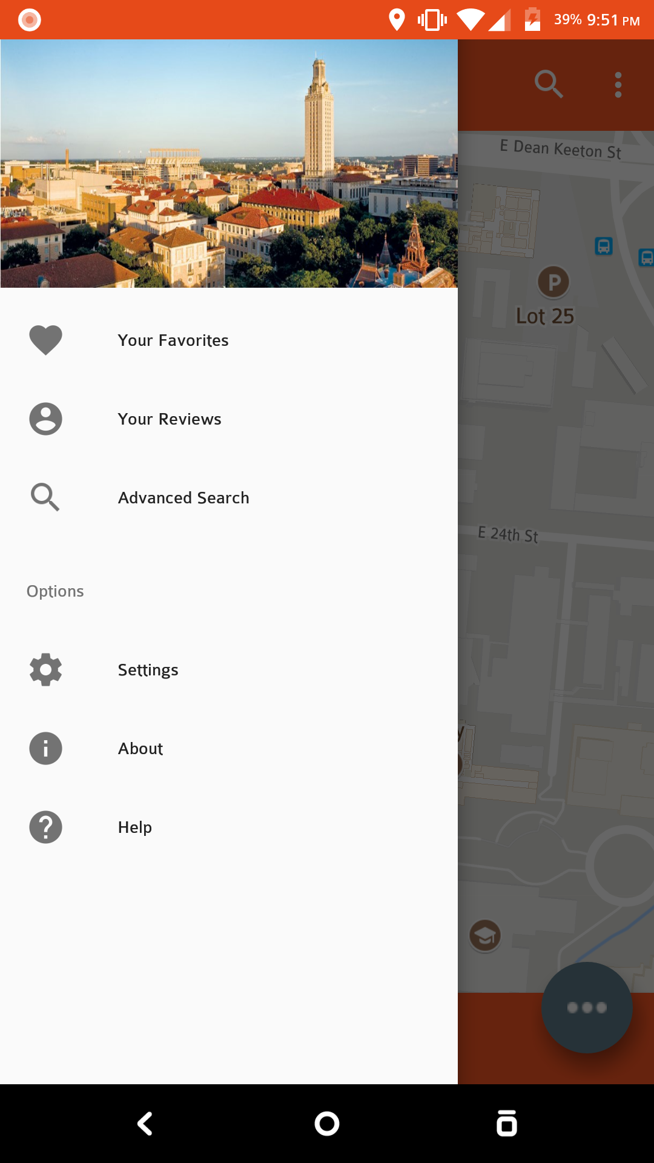
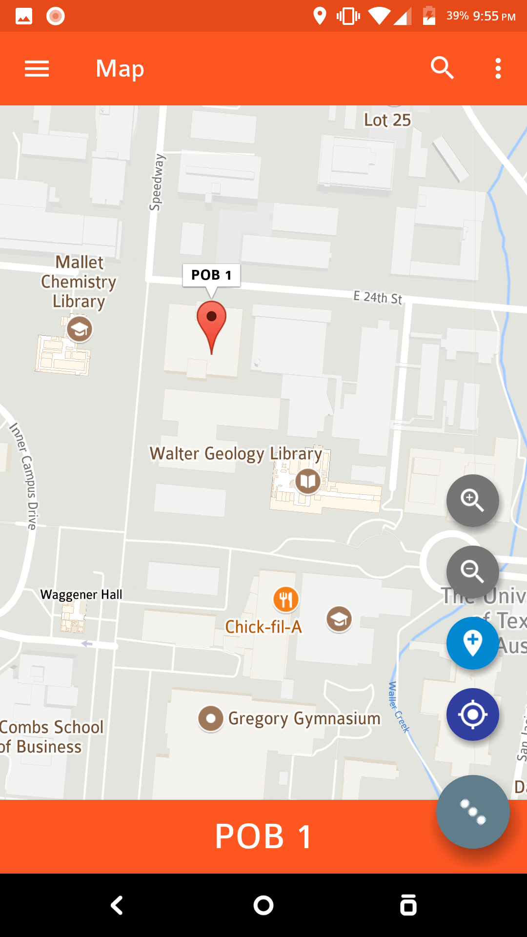
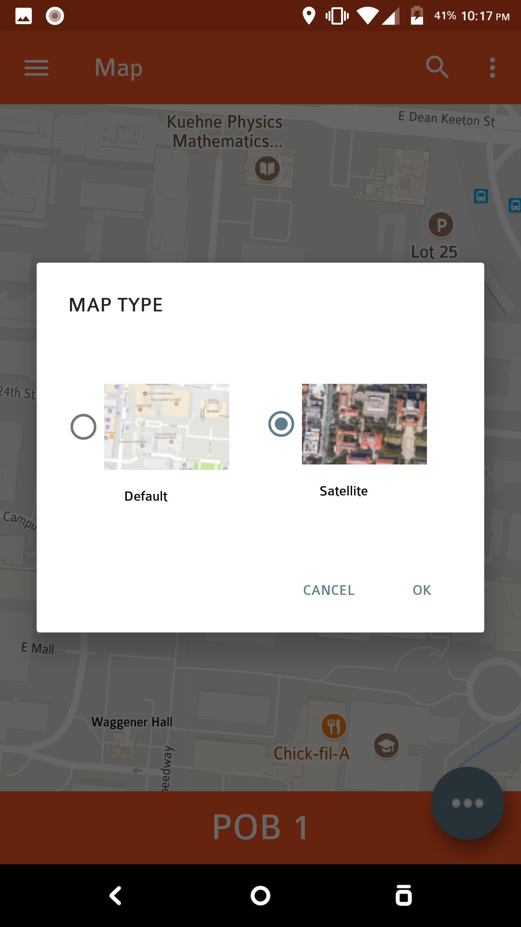
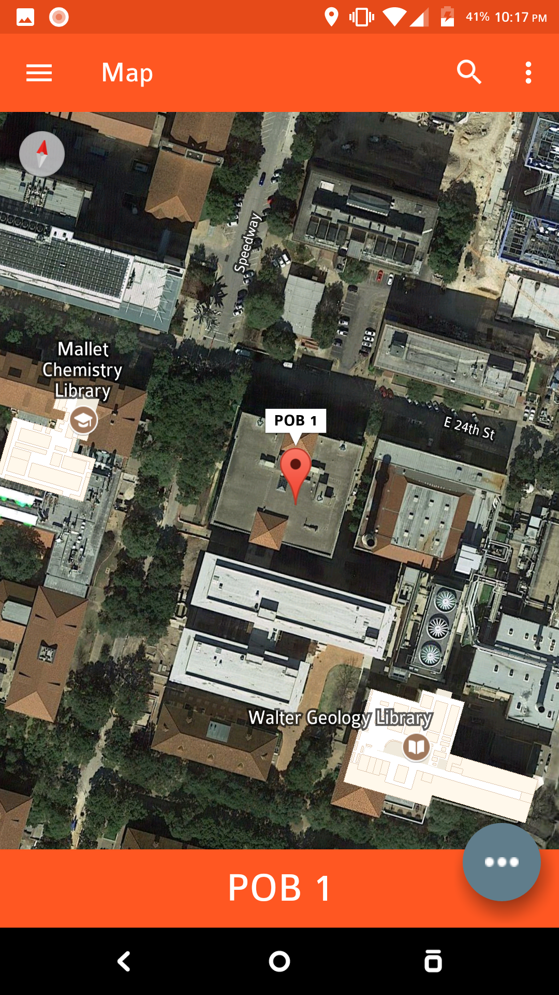
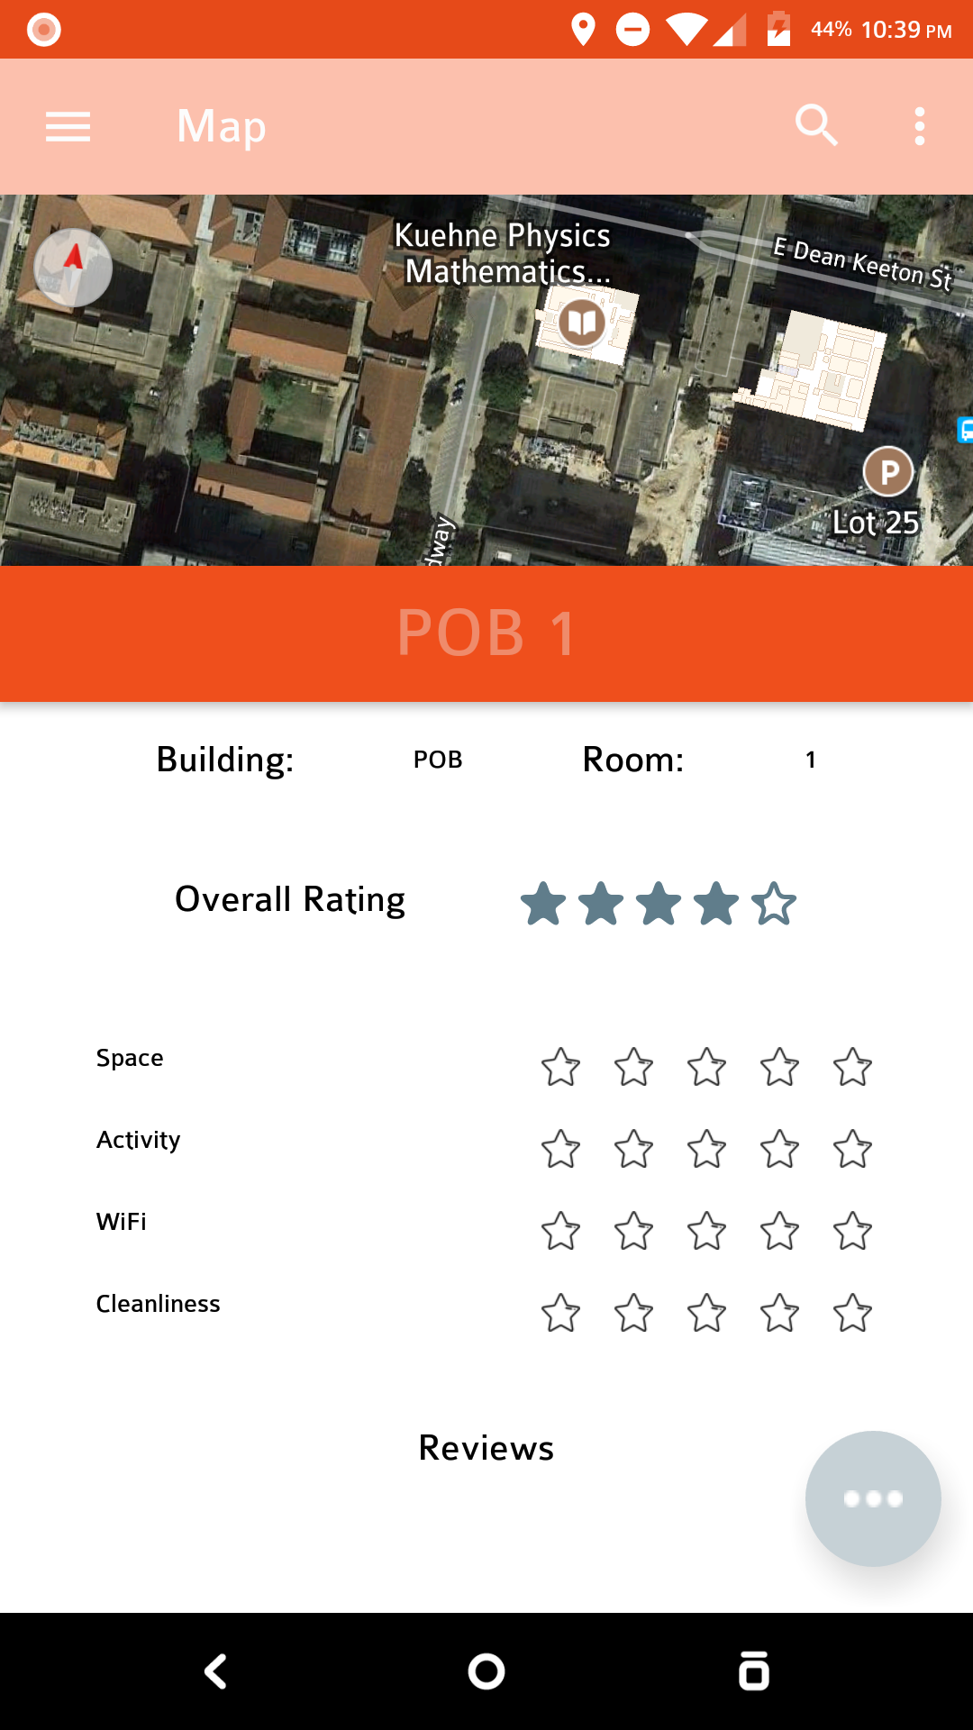
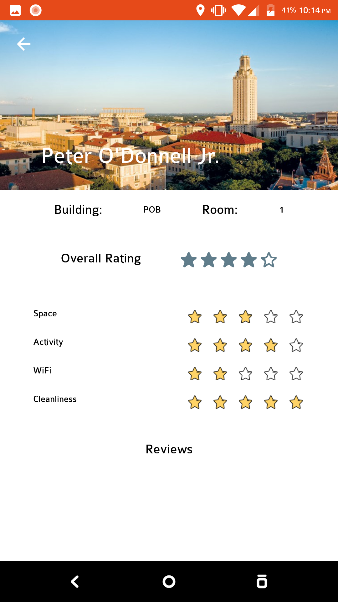
Updates
Finished/In Progress
Mapview with Location Tracking
Location Pins
Firebase Standalone Project
Todo List
Firebase Merge for Location Database
Location Search/Filter
Initial data collection for initial ratings

